Slide 1







TECHNOLOGY TRENDS
BY: KRISHNA CHAITANYA KOTABHATTARA
SUBMITTED ON: 2023-08-23

Slide 2



OUTLINE
Executive Summary
Introduction
Methodology
Results
Visualization – Charts
Dashboard
Discussion
Findings & Implications
Conclusion
Appendix

Slide 3

EXECUTIVE SUMMARY
Web technologies: JavaScript, HTML, CSS are the most popular web technologies.
Web frameworks: React.js and jQuery are the hottest web frameworks.
Development platforms: Windows and Linux are the most popular development platforms.
Mobile platforms: Android is the most popular mobile platform.
Databases: MySQL is the most popular database, but MongoDB and PostgreSQL are gaining popularity.

Slide 4

INTRODUCTION
Technology market: The technology market is constantly changing, so it is important to stay up-to-date with the latest trends.
Latest technology: The latest technology in each field can provide a competitive edge.
Technology trend: Comparing the current and next year technology trends can give you insights into the market.
Study: The study consists of four main parts:
Top language: The most popular programming languages.
Top database: The most popular databases.
Top platform: The most popular development platforms.
Top web frame: The most popular web frameworks.

Slide 5

METHODOLOGY
Technology trend: The study of the current and future usage of technology.
Data: The data was from the Stack Overflow Developer Survey 2019.
Visualization: Different types of charts, such as bar, line, pie, tree-map, will be used to visualize the data.
Dashboard: The IBM dashboard will be used to analyze the data and create the visualizations.

Slide 6

RESULTS
The results consists of 4 main parts:
Programming language trend
Database trend
Platform trend
Web frame trend

Slide 7
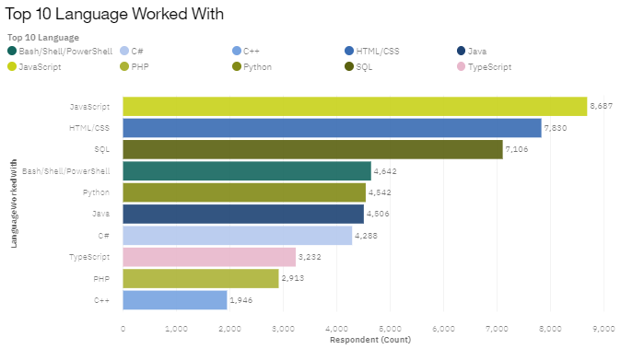
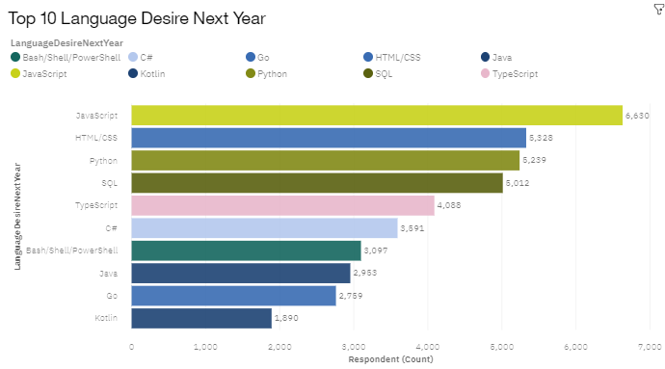
PROGRAMMING LANGUAGE TRENDS
Current Year
Next Year

Slide 8
PROGRAMMING LANGUAGE TRENDS - FINDINGS & IMPLICATIONS
Findings
JavaScript and HTML/CSS are the most popular programming languages for web development.
Python is becoming increasingly popular for data science, machine learning, and artificial intelligence.
C++ and PHP are being replaced by newer languages, such as Rust and Go.
Implications
Web programming languages will still dominate the near future.
Python and data science are becoming increasingly important.
Legacy languages such as C++ and PHP are gradually falling out of interest.

Slide 9
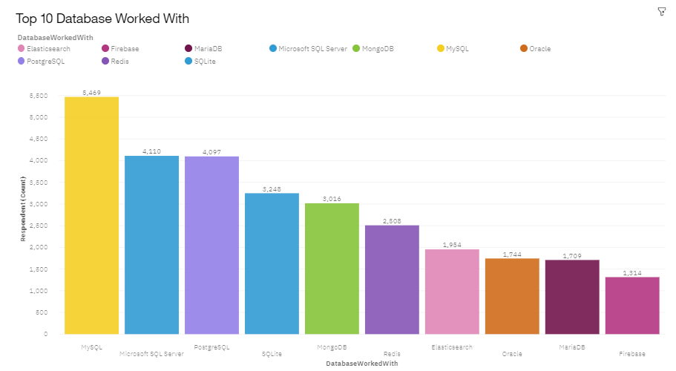
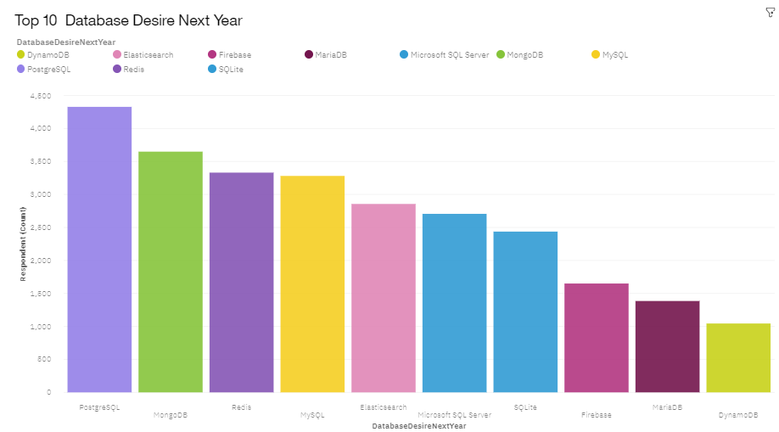
DATABASE TRENDS
Current Year
Next Year

Slide 10
DATABASE TRENDS - FINDINGS & IMPLICATIONS
Findings
MongoDB and Redis are quickly gaining popularity and are now ranked 2nd and 3rd, respectively.
PostgreSQL has moved up to the top spot, replacing MS SQL Server.
MS SQL Server has dropped to the 5th spot, and Oracle has disappeared from the top 5.
Implications
Open source databases are becoming more popular than commercial databases.
Non-relational databases are seeing increasing usage, but relational databases still take the lead.

Slide 11
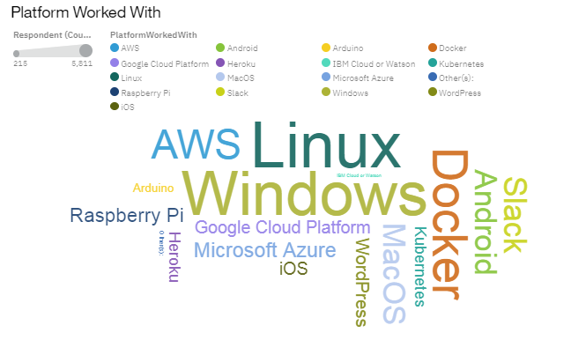
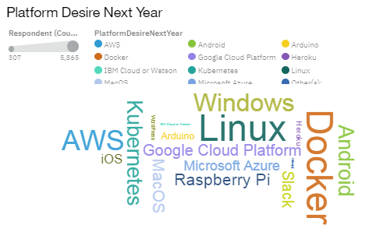
PLATFORM TRENDS
Current Year
Next Year

Slide 12
PLATFORM TRENDS - FINDINGS & IMPLICATIONS
Findings
Windows and Linux are still the dominant platforms for both desktop and server applications.
Android is the No. 1 mobile platform, followed by iOS and Windows Phone.
Cloud platforms such as Kubernetes, Docker, and AWS are gaining more and more market share.
Implications
Windows and Linux are still the main development platforms in the foreseeable future.
The transformation to cloud computing is a non-reversible process.

Slide 13
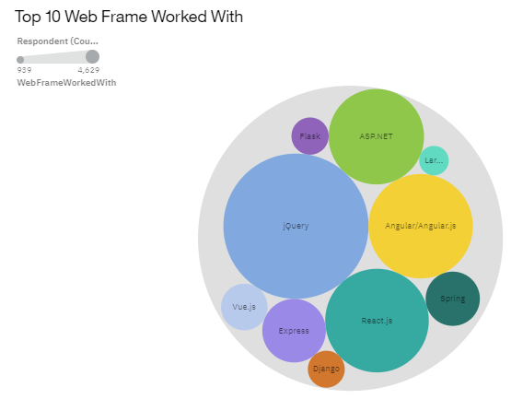
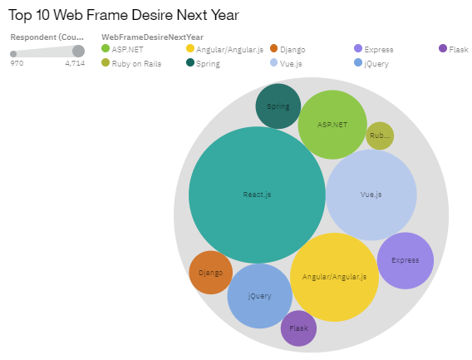
WEB FRAME TRENDS
Current Year
Next Year

Slide 14
WEB FRAME TRENDS - FINDINGS & IMPLICATIONS
Findings
jQuery's popularity has decreased, while React.js and Vue.js have become more popular.
Angular.js has remained relatively stable in popularity.
Implications
jQuery has lost market share and is no longer the standard for web framework development.
React.js and Vue.js have become the new standard for web framework development.

Slide 15
DASHBOARD
https://github.com/DrRuin/IBM-Data-Analyst/blob/main/IBM%20Data%20Analyst%20Capstone%20Project/Cognos%20Dashboard.pdf
- Github link cause I don’t want it to get lost in future and can come back, take a look at anytime I want !

Slide 16
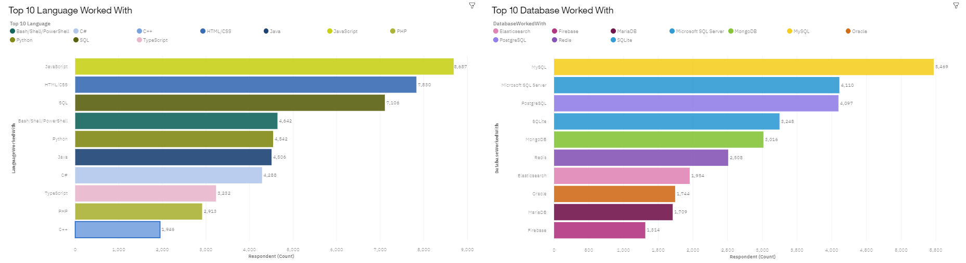
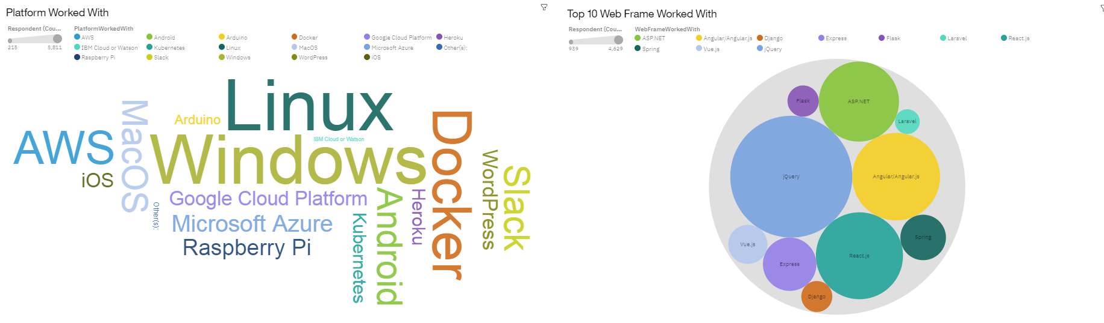
DASHBOARD TAB 1

Slide 17
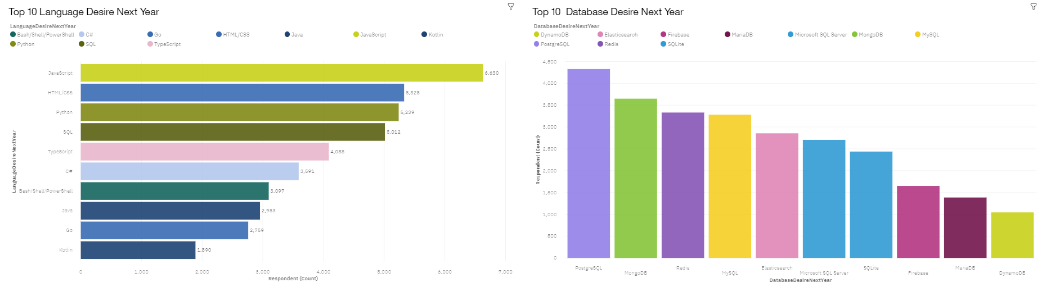
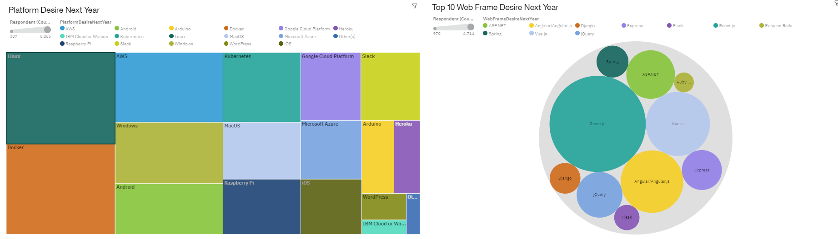
DASHBOARD TAB 2

Slide 18
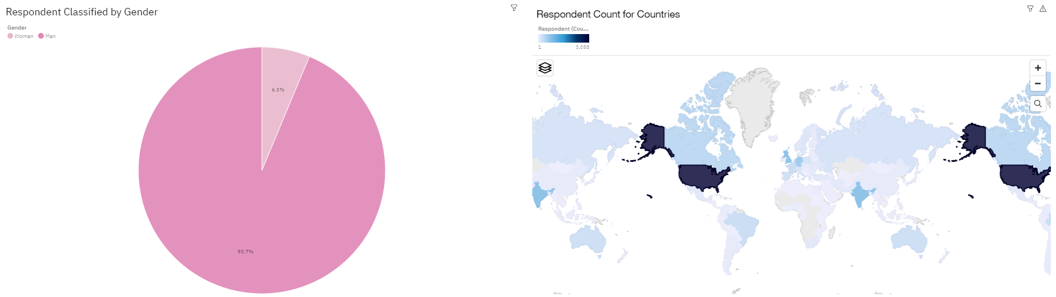
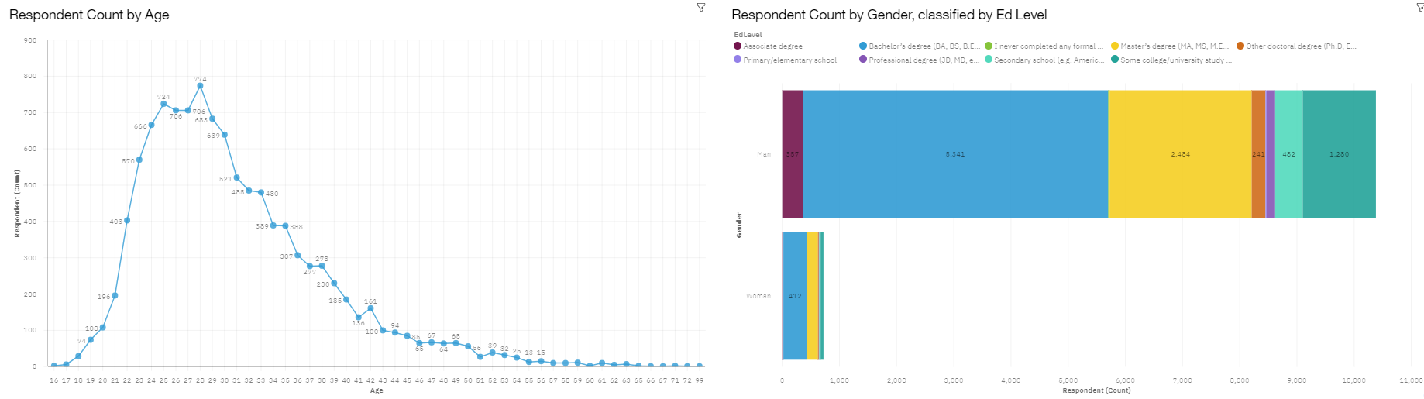
DASHBOARD TAB 3

Slide 19
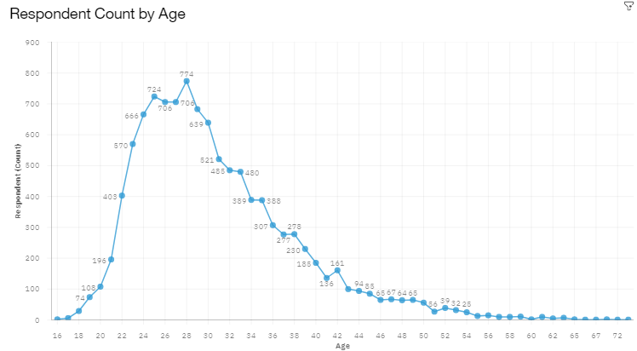
DISCUSSION
Majority of respondents are at young age (20, 30s) ➔ this could skew the result in favor of new technology.

Slide 20
OVERALL FINDINGS & IMPLICATIONS
Findings
Web-based languages are still the most popular, with JavaScript staying at the top.
Non-relational databases are gaining popularity, with MongoDB and Redis moving to the 2nd and 3rd spots.
Cloud-based platforms are becoming more popular, with AWS moving to the top spot.
React.js remains the most popular web framework.
Implications
Web-based applications are taking over traditional applications.
Non-relational databases are seeing increasing adoption.
Cloud-based services are becoming the top choice for platform development.

Slide 21

CONCLUSION
To stay relevant in the technology field, it is important to learn web-based languages and non-relational databases.
React.js is the best web framework to learn for your future.
Cloud-based services are the right direction for IT investment.

Slide 22
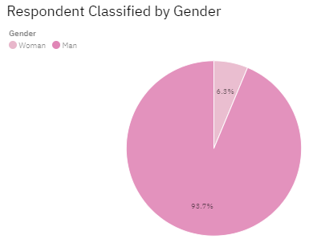

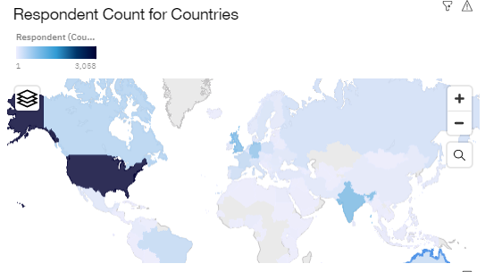
APPENDIX

Slide 23
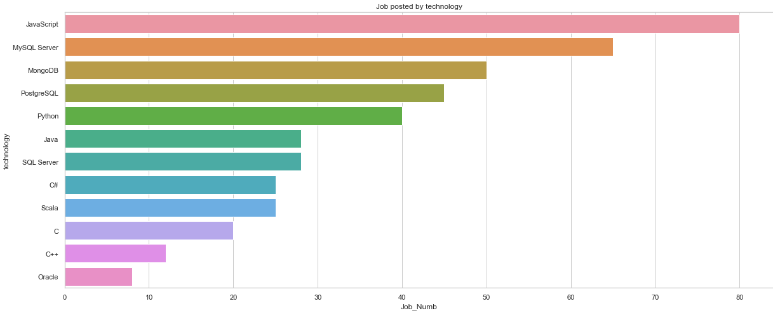
GITHUB JOB POSTINGS

Slide 24
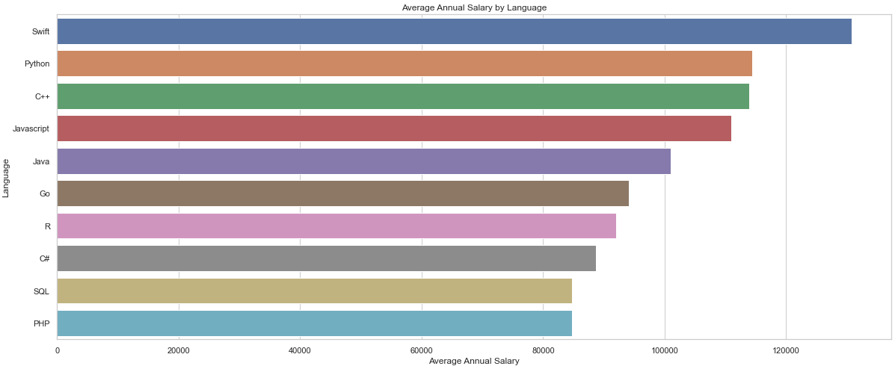
POPULAR LANGUAGES
In Module 1 you have collected the job postings data using web scraping in a file named “popular-languages.csv”. Present that data using a bar chart here. Order the bar chart in the descending order of salary.

